Slide 1
GitHub
Ayala Badash

Slide 2
Agenda
GitHub Code Flow
Features​
GitHub Project Suggested Workflow
Summary

Slide 3


Introduction
Git – a distributed version control that allows multiple developer or other contributors to work on a project. It provides a way to work with one or more local branches and push them to a remote repository. Git is responsible for everything GitHub-related that happens locally on your computer.
GitHub – a cloud platform that uses Git as its core technology. It simplifies the process of collaborating on projects and provides a website, command-line tools, and overall flow that allows developers and users to work together. GitHub acts as the "remote repository"
05/04/2022
GitHub

Slide 4
GitHub Code Flow

Slide 5
GitHub Code Flow
Create a branch: Create a branch with a short and descriptive name. By creating a branch, you create a space to work without affecting the default branch. Additionally, you give your collaborators a chance to review your work
1
Make changes: On your branch, make changes to the repository. Your branch is a safe place to make changes. If you make a mistake, you can revert your changes or push additional changes to fix it. Add, commit (with a meaningful comment) and push your changes. Repeat until finish
2
Create a PR (pull request): Create a PR to ask for your collaborators for feedback. You can also require an approving review before PR can be merged. If you want it to be quick, you can mark it as draft. PR includes summary, the problem it solves, images, tables and even linked issues
3
Address review comments: Reviewers should leave questions, comments, and suggestions. You can continue to commit and push changes in response to the reviews. Your pull request will update automatically
4
Merge your PR: Once your pull request is approved, merge your pull request. This will merge your branch to the default branch. GitHub retains the history of comments and commits in the PR to help future contributors understand your changes.
5
Delete your branch: After you merge your pull request, delete your branch. This indicates that the work on the branch is complete and prevents you or others from accidentally using old branches.
6

Slide 6
Features

Slide 7
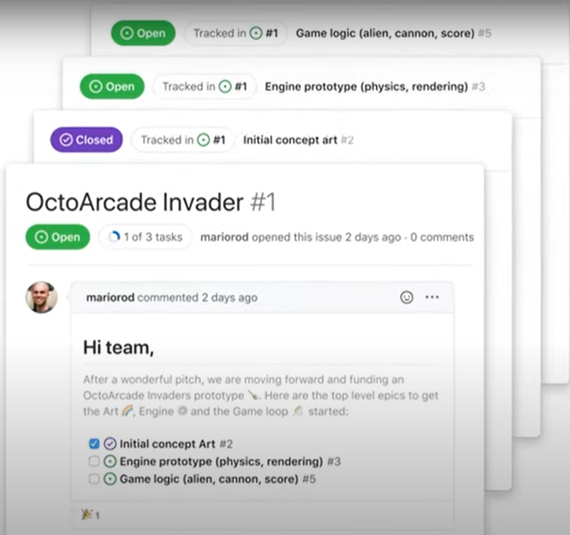
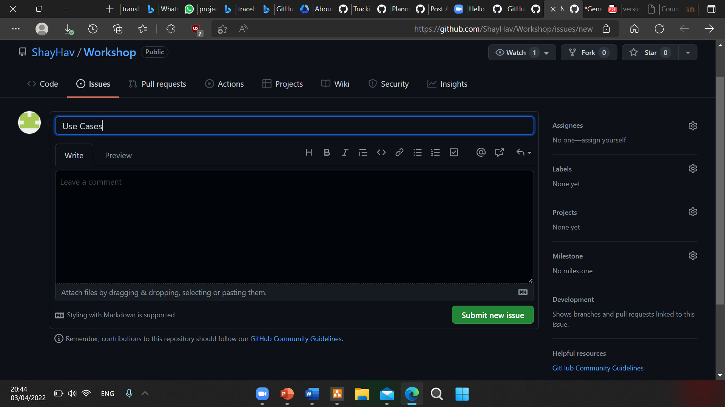
Issues
Issues are where most of the communication occurs. An issue can be created to discuss a broad set of topics
Once an issue has been created, it can be assigned to owners, labels, projects, and milestones
You can also associate issues with pull requests and other GitHub items to provide future traceability

Slide 8
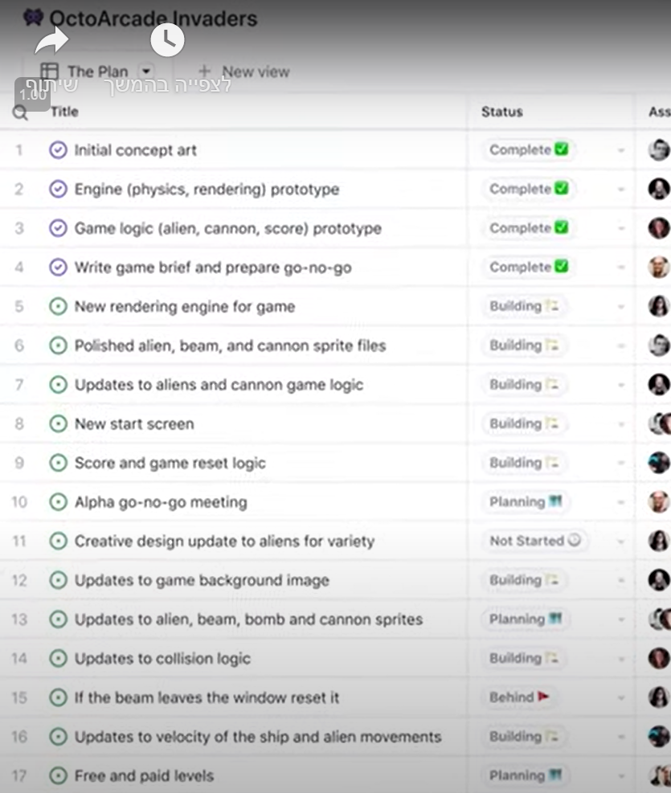
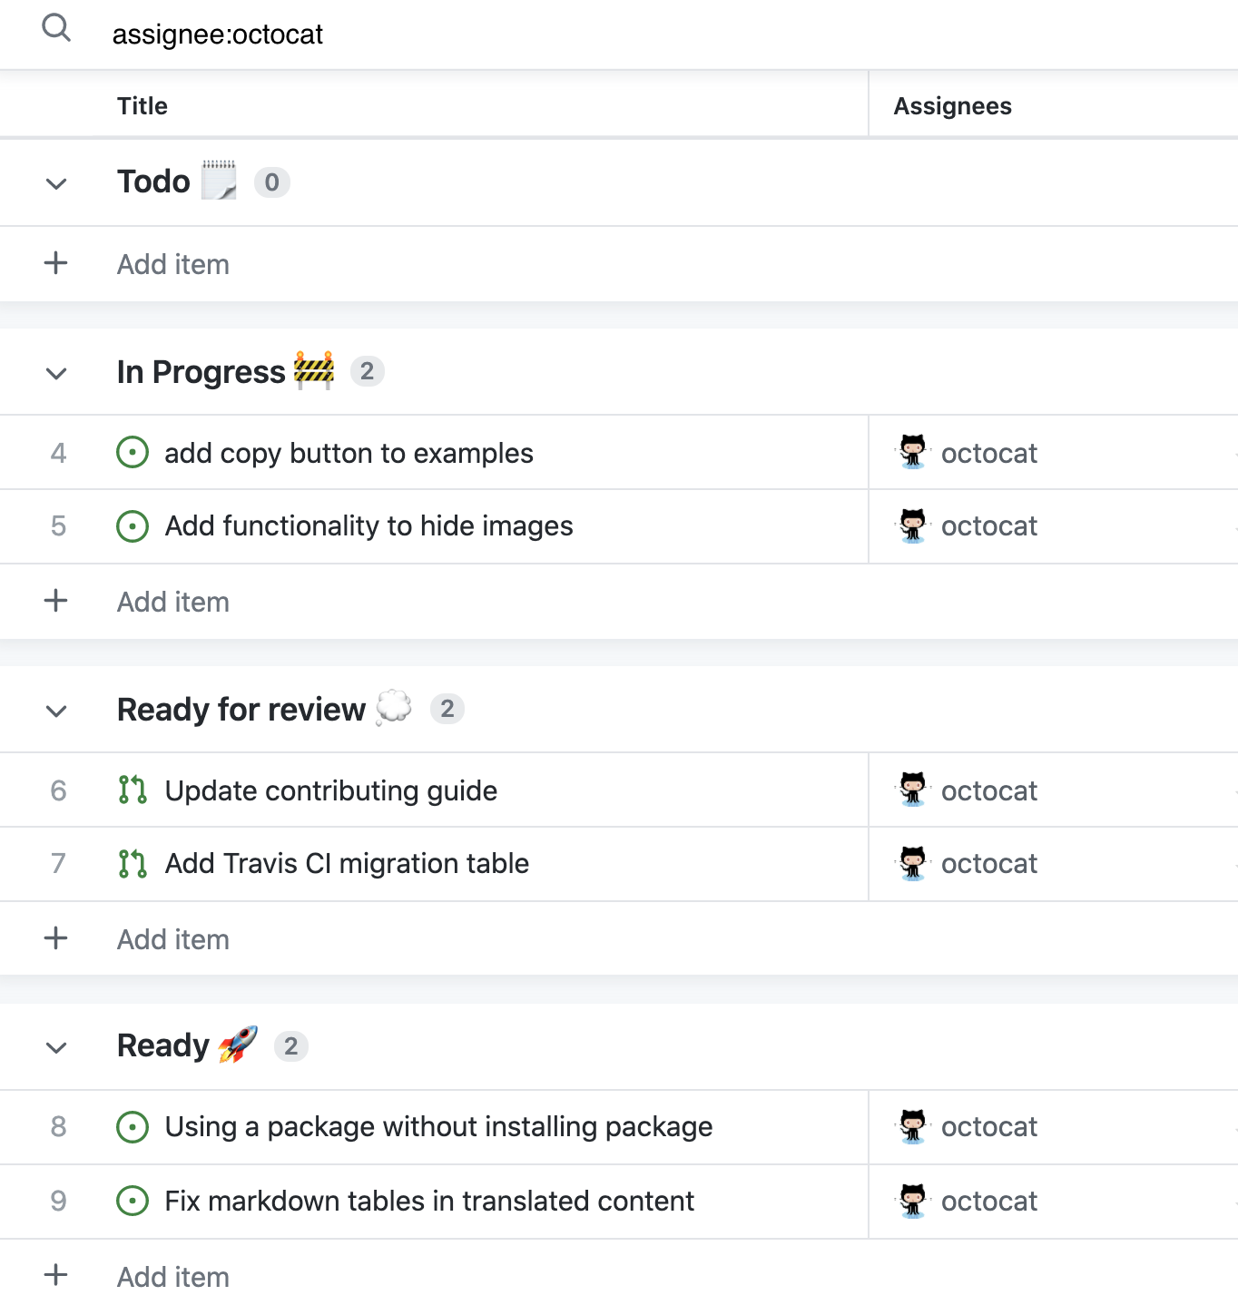
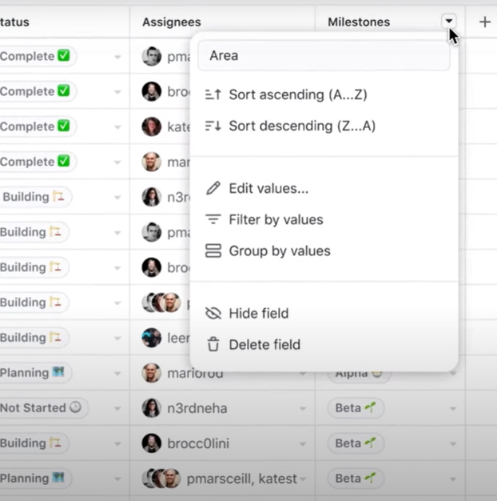
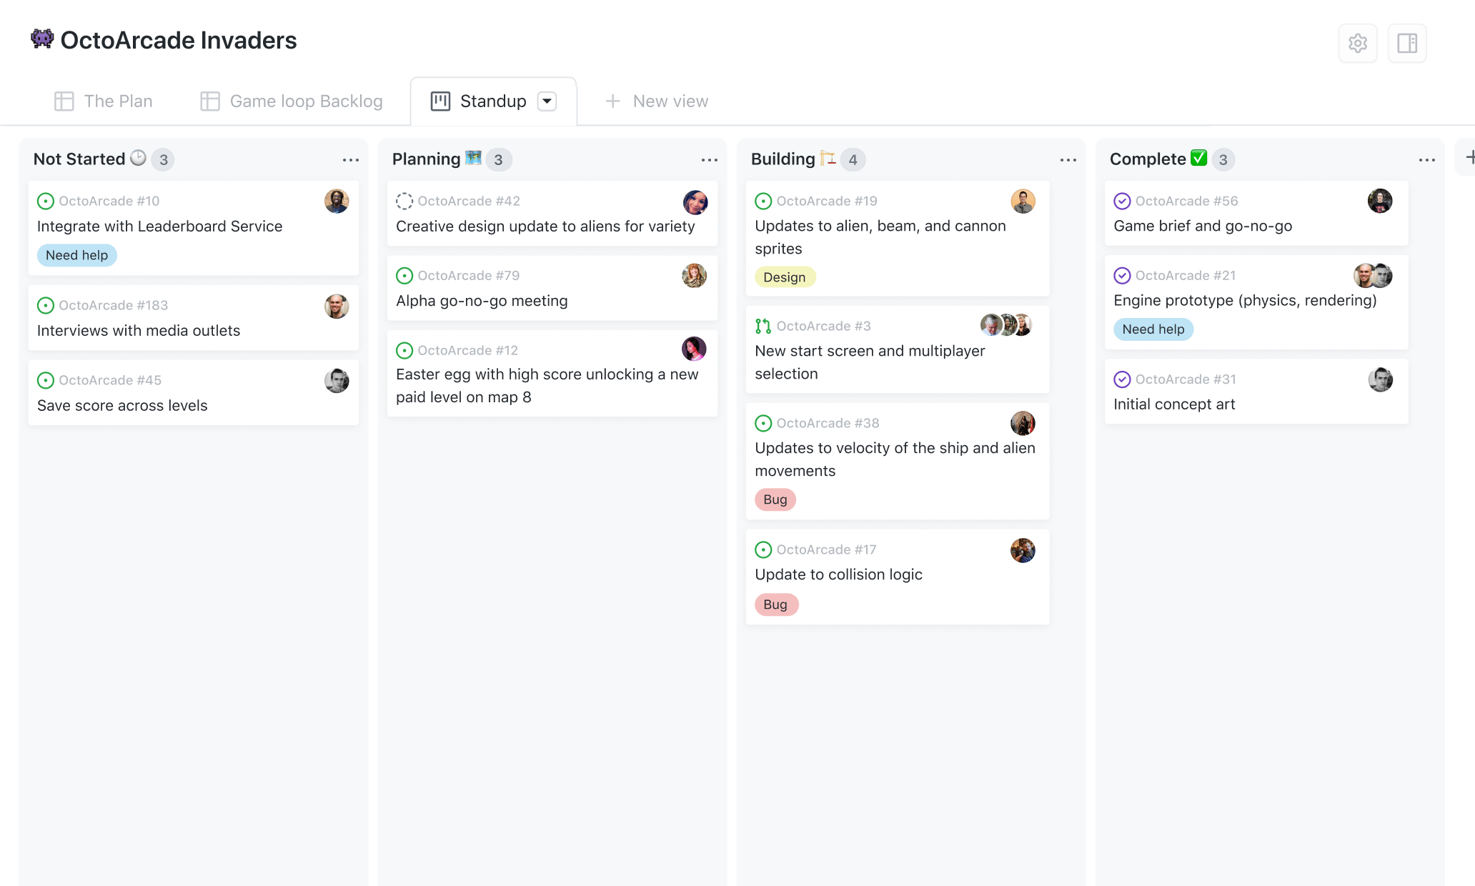
projects
A project is a customizable spreadsheet that integrates with your issues and pull requests
You can customize the layout by filtering, sorting, and grouping your issues and PRs. You can also add custom fields to track metadata
Each teammate can have its own project, with his assigned issues
There is an option of automated triggers – triggers that automatically move tasks around

Slide 9
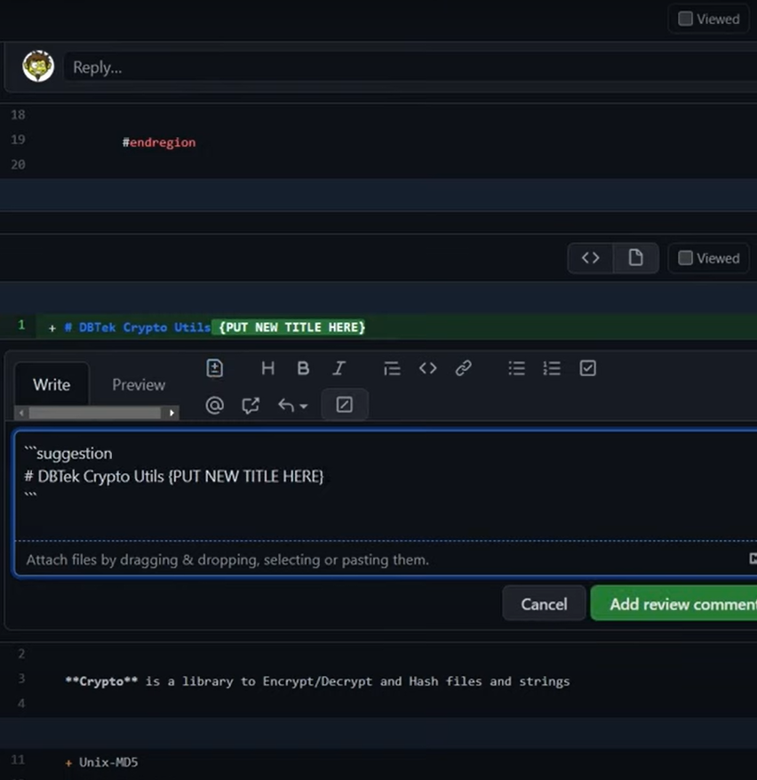
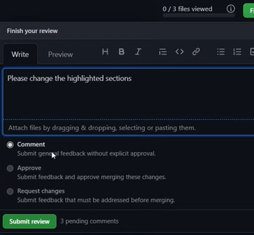
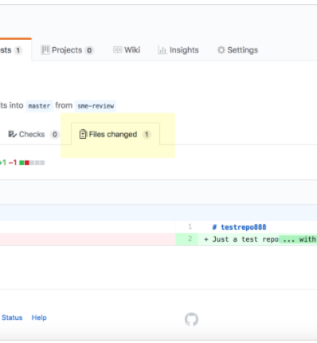
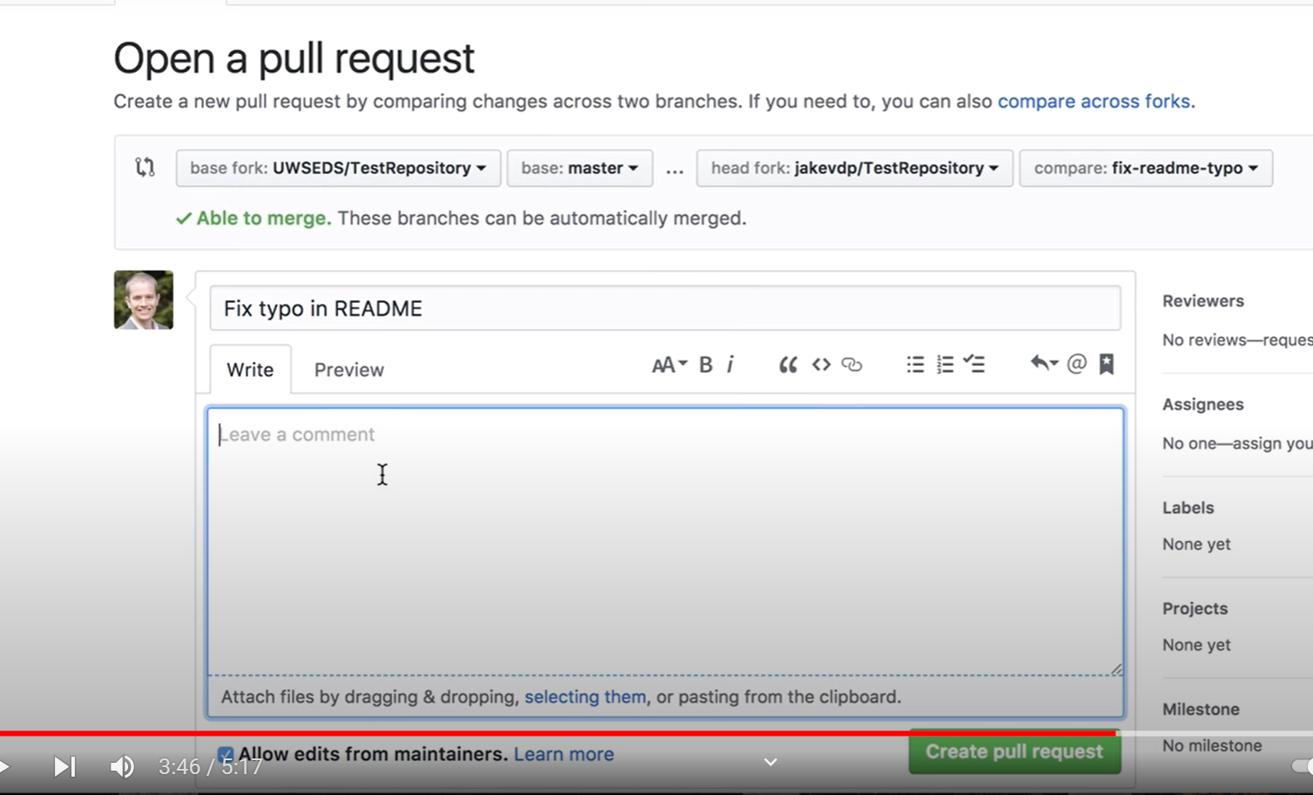
Pull requests
Pull requests let you tell others about changes you've pushed to a branch in a repository on GitHub. Once a pull request is opened, you can discuss and review the potential changes with collaborators and add follow-up commits before your changes are merged into the base branch

Slide 10
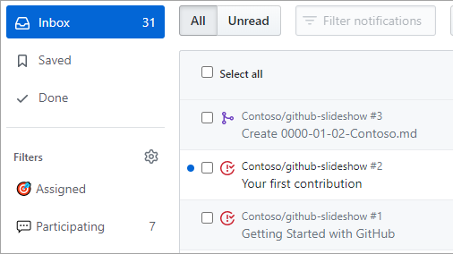
Notification
GitHub offers notifications for events that take place within a given workflow. These notifications are managed by your preferences. You can subscribe to all issue creations and edits on a project, or you can just receive notifications for issues in which you are mentioned. You can also decide on which platform to receive the notifications

Slide 11
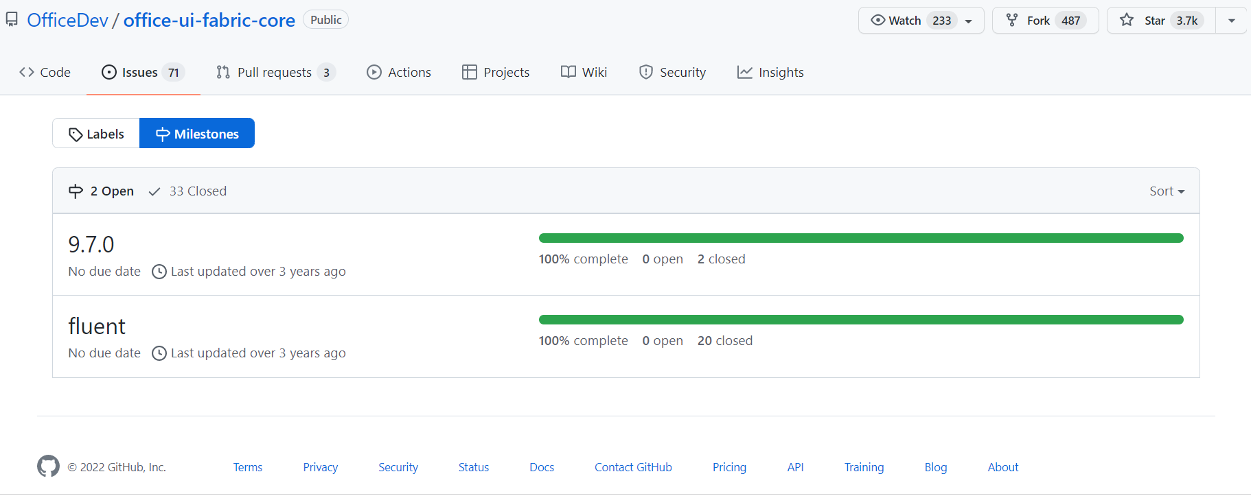
Milestones
You can use milestones to track progress on groups of issues or pull requests in a repository
A user-provided description of the milestone
The milestone's due date
The milestone's completion percentage
The number of open and closed issues and pull requests associated with the milestone
A list of the open and closed issues and pull requests associated with the milestone

Slide 12
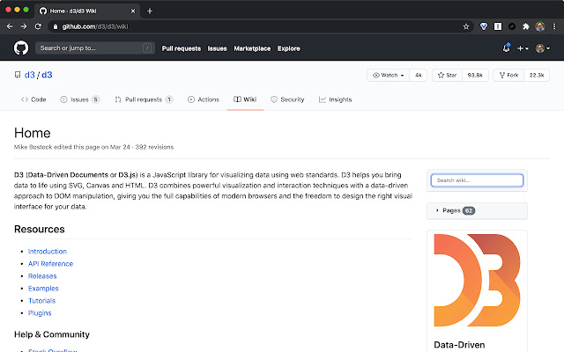
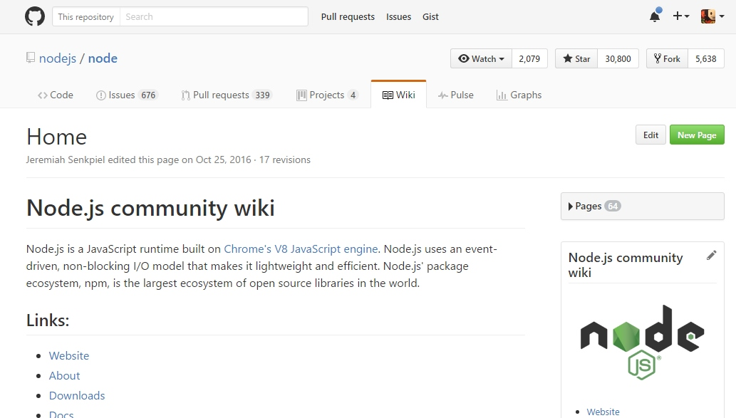

Wiki
Every GitHub repository comes with a section for hosting documentation, called a wiki
We can use this to provide detailed information about the project - its design, its purpose, and its goals
It can also include any other additional documentation that will help others use and contribute to the project

Slide 13
GitHub Project Suggested Workflow

Slide 14
GitHub Project Suggested Workflow
Create a new project
1
Configure your project board to automate columns (new issues are placed in the “to-do” column, etc.)
2
Create a new milestone
3
Create issues/pull requests and associate them with the relevant milestones & projects
4
Work by GitHub code flow
5

Slide 15
The way to get started is to quit talking and begin doing.
Walt Disney

Slide 16

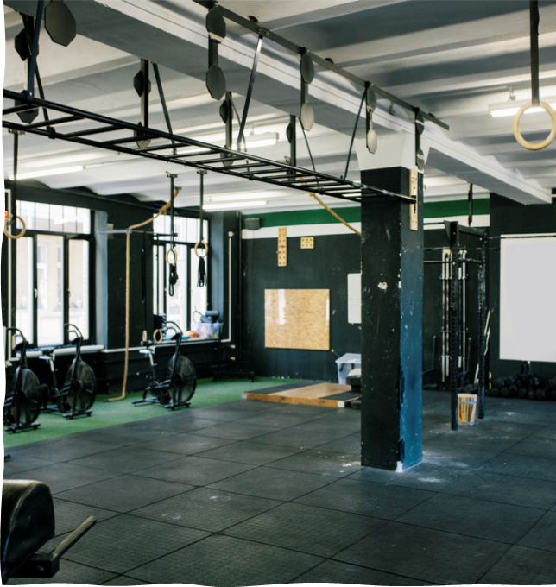
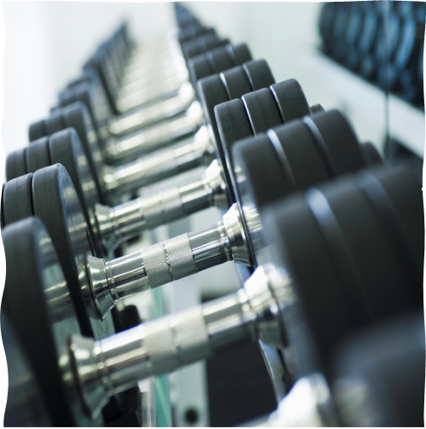

Summary
I think GitHub is a good, neat and free way to run a multi-participant project. It Allows you to track project progress, changes made in it and related tasks. In addition, it allows mutual fertilization of team members
05/04/2022
GitHub
16

Slide 17

Thank you

